Slide 1
AuE-8230 Autonomy: Science and Systems
Capstone Project
Review Presentation 1
Group 1: Chinmay Samak, Tanmay Samak

Slide 2
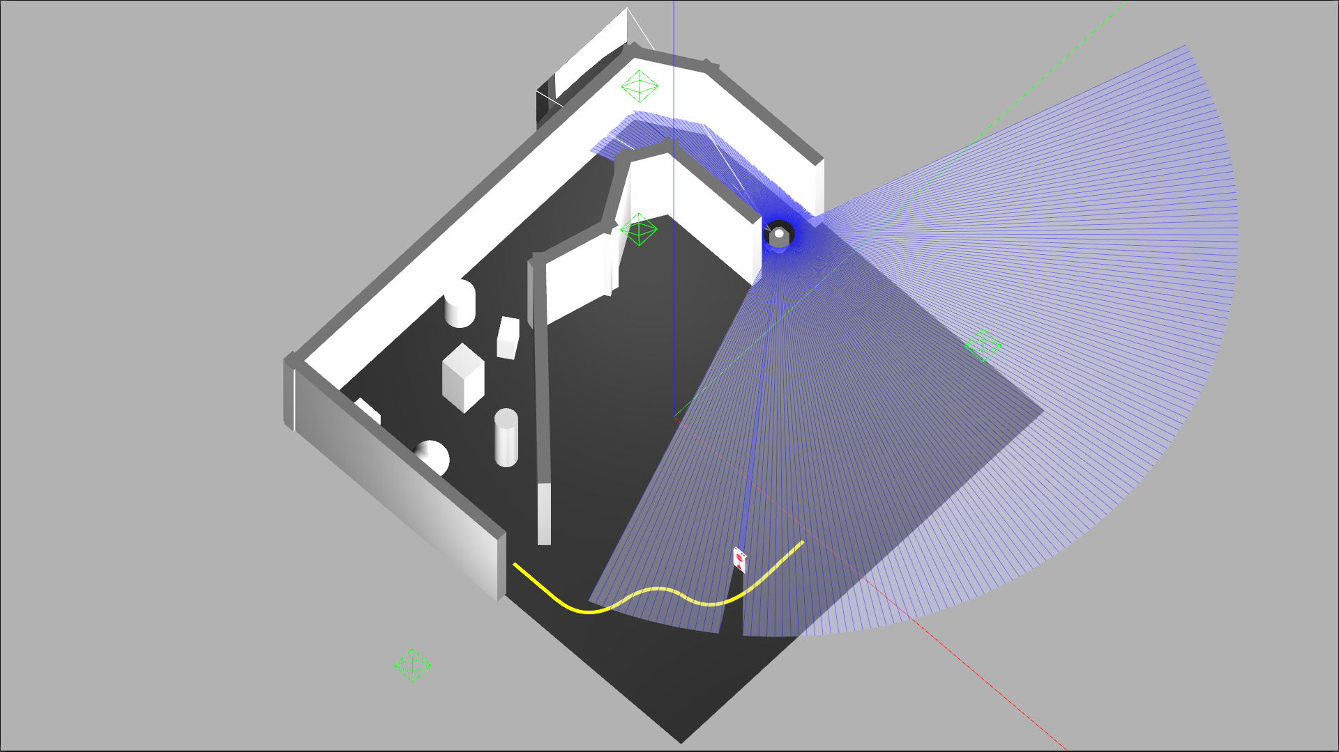
Project Tasks
Task 1: Wall Following
Task 2: Obstacle Avoidance
Task 3: Line Following
Task 4: Stop Sign Detection
Task 5: AprilTag Tracking

Slide 3
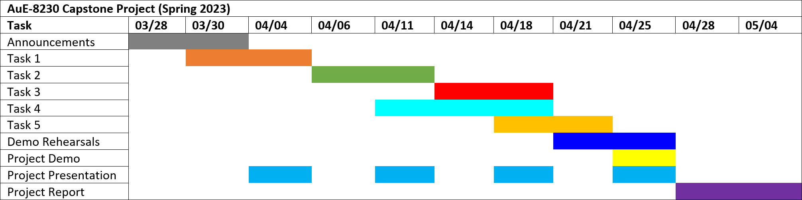
Project Timeline
Task 1: Wall Following
Task 2: Obstacle Avoidance
Task 3: Line Following
Task 4: Stop Sign Detection
Task 5: AprilTag Tracking

Slide 4
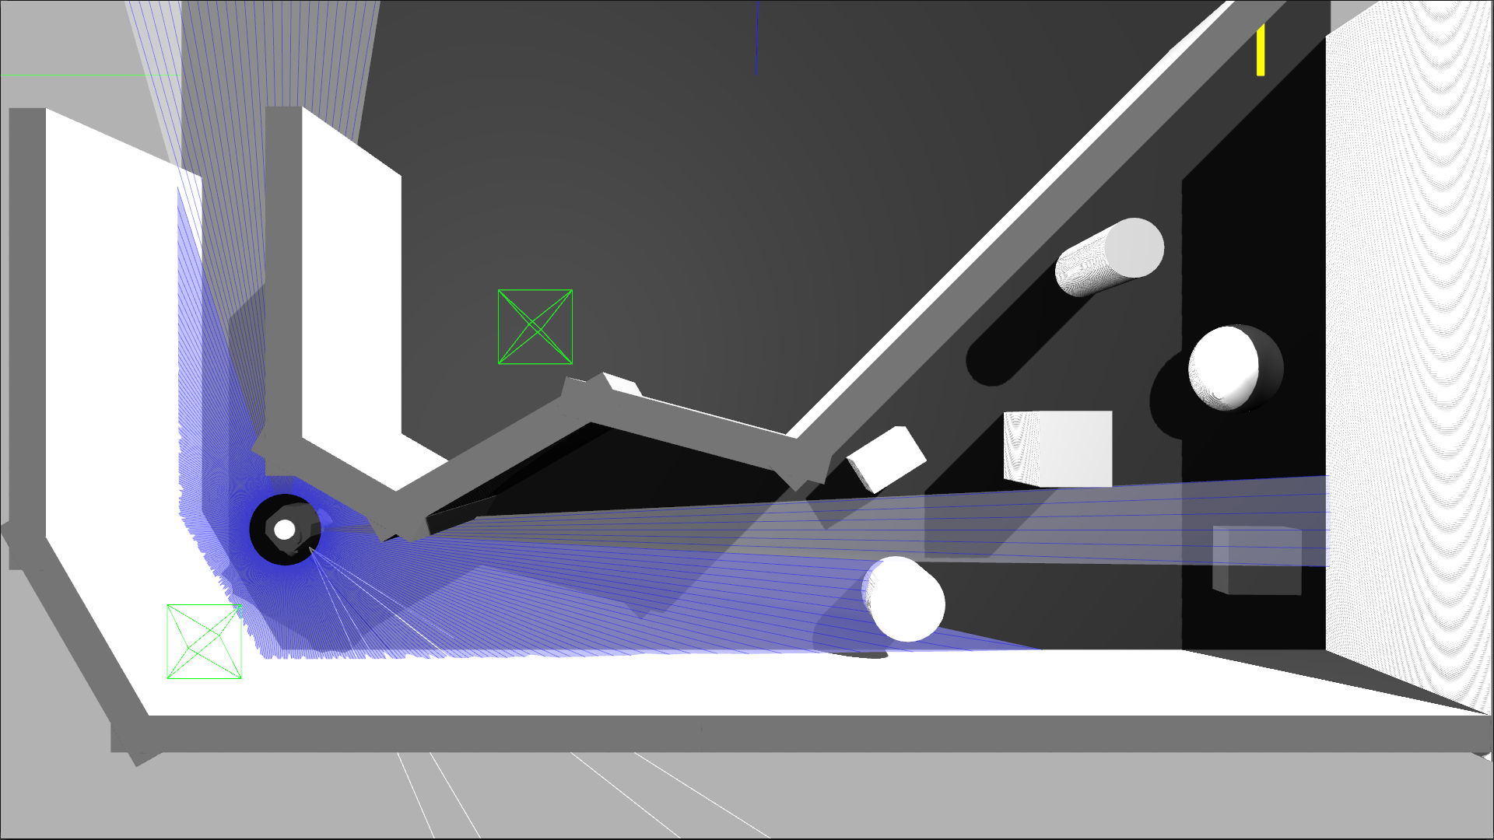
Task 1
Wall Following

Slide 5
Primary Responsibility Assignment
Algorithm development: Tanmay
Simulation setup: Chinmay
Simulation deployment: Chinmay
Real-world deployment: Tanmay
Git repository management: Chinmay
Documentation: Tanmay
Note: Responsibility does not indicate contribution. Both members contributed equally to this project and have no conflict of interest to declare.

Slide 6
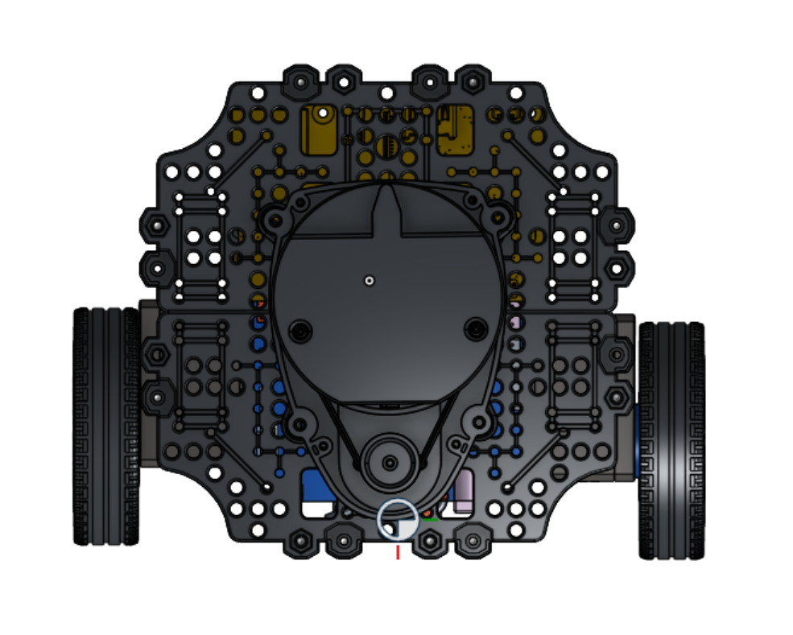
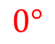
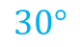
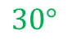
Approach
$$0°$$
Framework: ROS 2
Robot: TurtleBot3
Sensors: LIDAR
Algorithm:
Front laser scan ranging measurement [0]
Left [75:105] and right [255:285] laser scan sectors
De-coupled lat-lon PID controller architecture
Adaptive cruise control based on frontal range
Cross-track error based on mean left and right ranges
Safety mechanisms and bounds (inf range, on-spot turn, actuation limits)
Codebase: GitHub
$$30°$$
$$30°$$

Slide 7
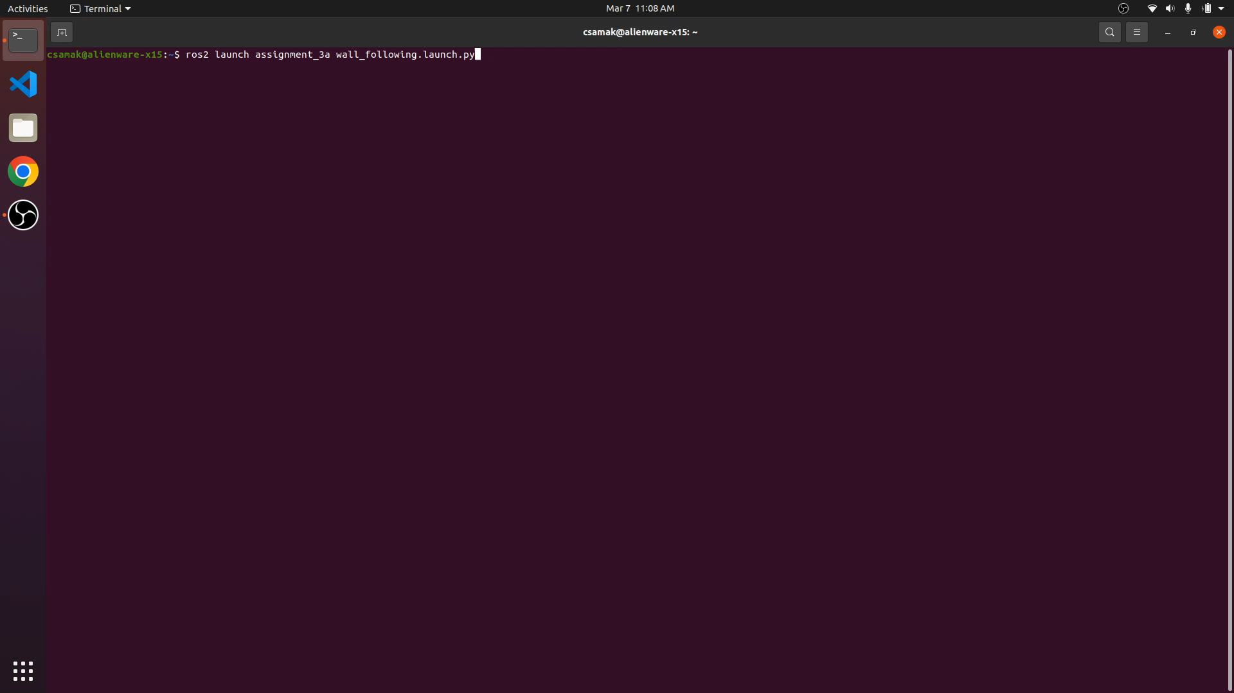
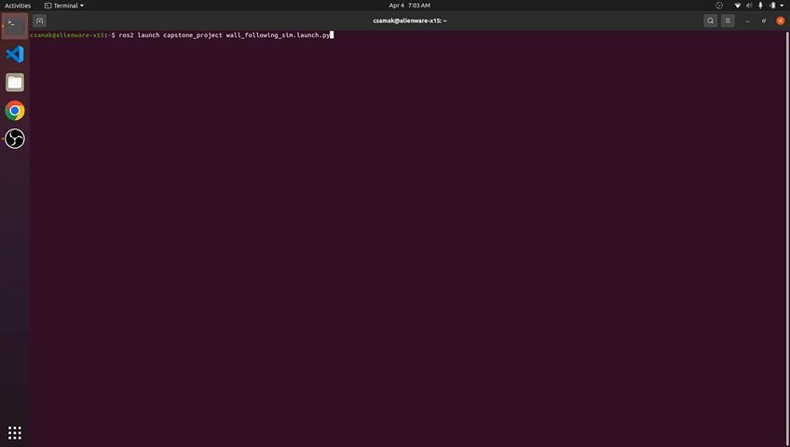
Simulation Results
Assignment World
Project World

Slide 8
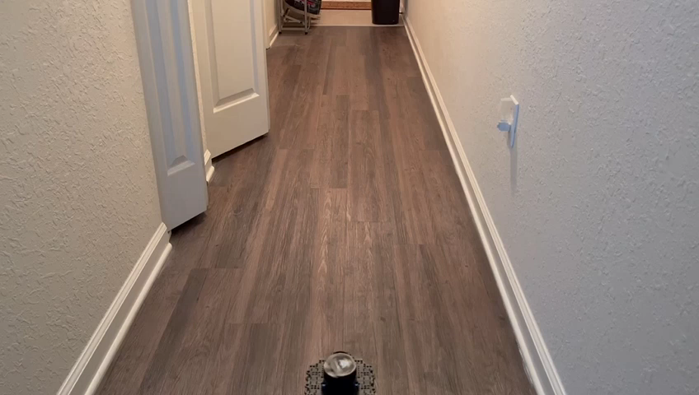
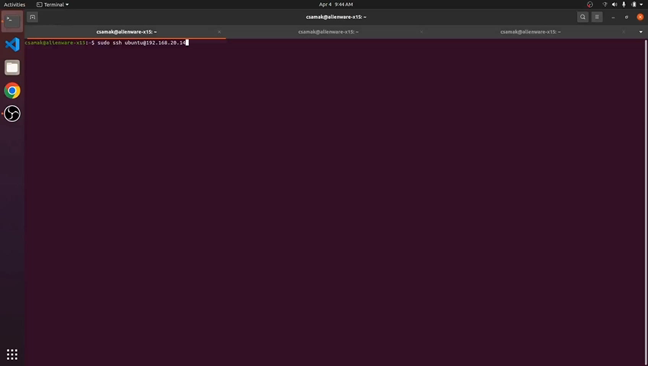
Real-World Results
Robot
Remote PC

Slide 9

Progress and Next Steps
Task 1: Wall Following
Task 2: Obstacle Avoidance
Task 3: Line Following
Task 4: Stop Sign Detection
Task 5: AprilTag Tracking
Calibration and optimization for final demo

Slide 10
Challenges Faced
ROS 2 DDS communication framework
Domain ID not robust to network traffic fluctuations
Topics not discoverable over network
Conflicting QoS profiles for sensors and actuators
Unavailable ROS 2 packages and lack of resources
Gazebo world and texture setup for ROS 2
Gazebo residual errors and crashes

Slide 11
Thank you!
…open to questions and suggestions

